Slide 1
Visual odometry and depth maps estimation

Slide 2
ReCAP

Slide 3
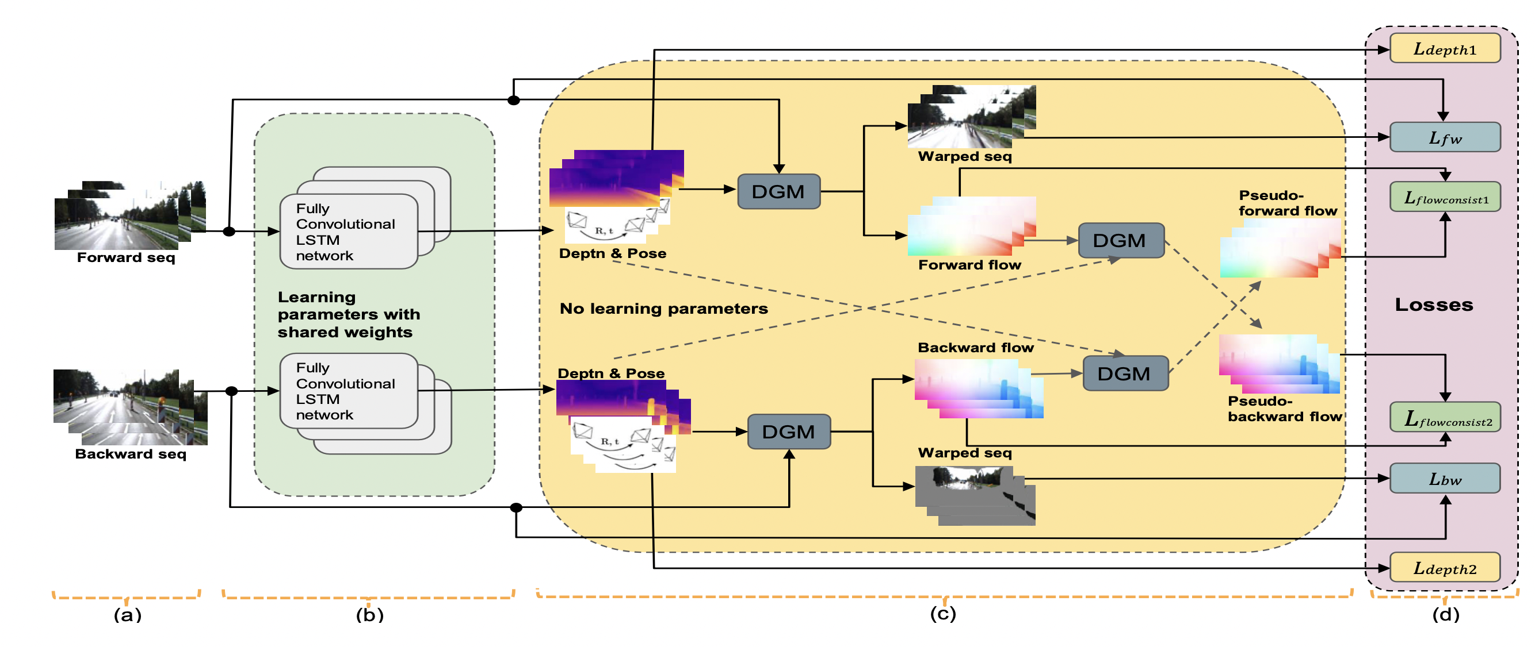
The network archeticture:

Slide 4
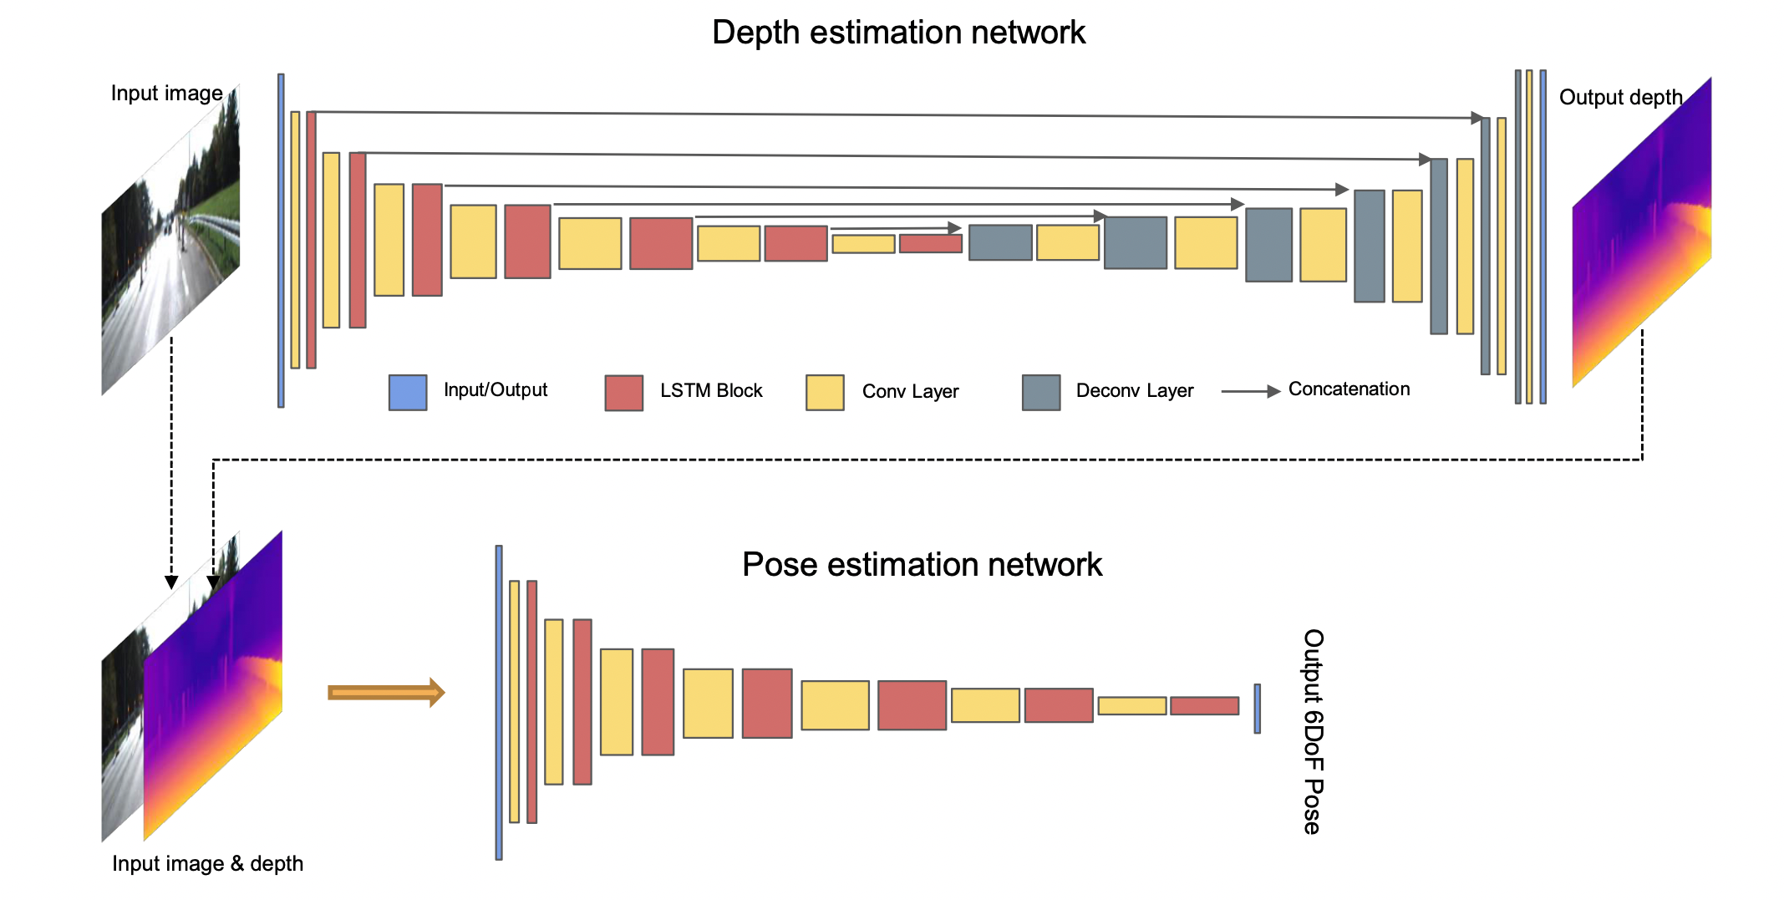

Slide 5
We trained the model with the papers provided hyperparameters and on all the KITTI and KITTI depth dataset for 135000 steps (27 epochs).
Those were less than the number of epochs stated in the paper which are a minimum of 30 or 40.

Slide 6
Hyperparameters used which were provided by the authors are:
Batch size: 3
Image height: 128
Image width: 416
Number of views per input (frames): 10
Learning Rate: 0.0001
Adam optimizer with beta: 0.9

Slide 7
OUR RESULTS

Slide 8
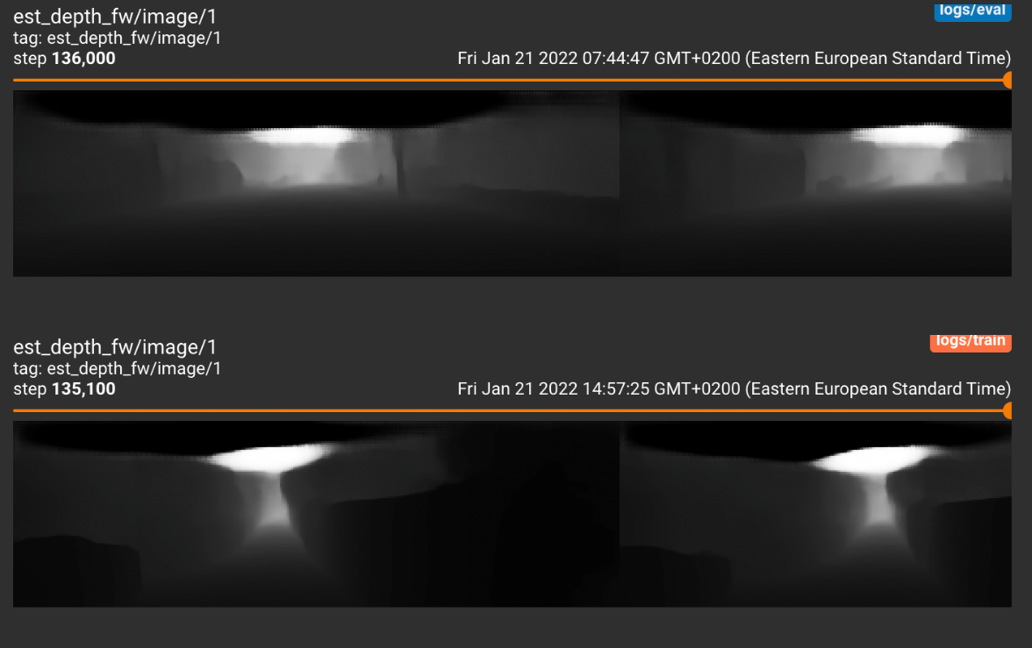
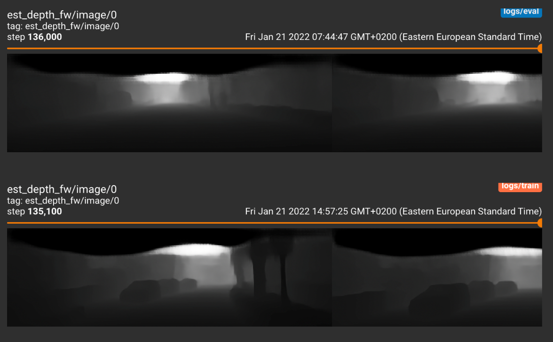
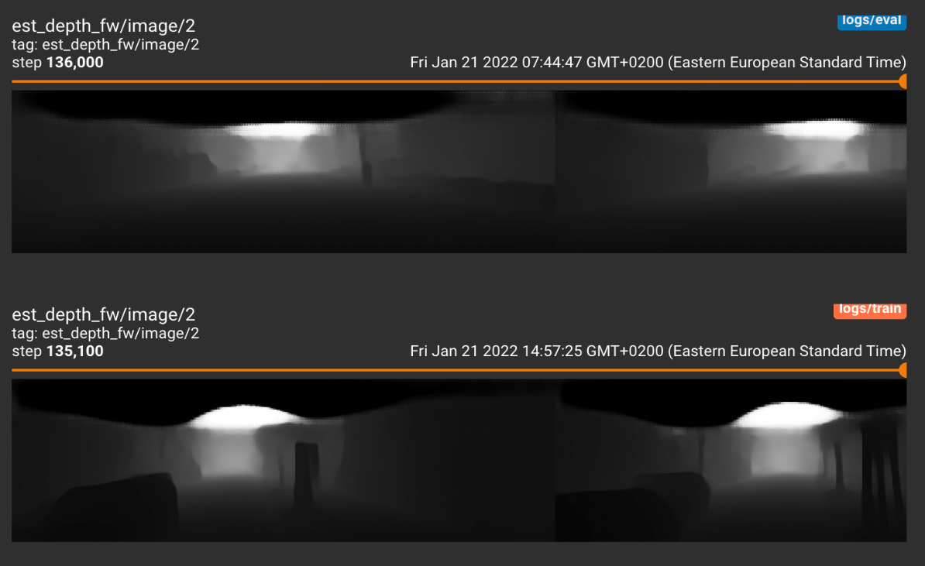
Depth Estimation

Slide 9
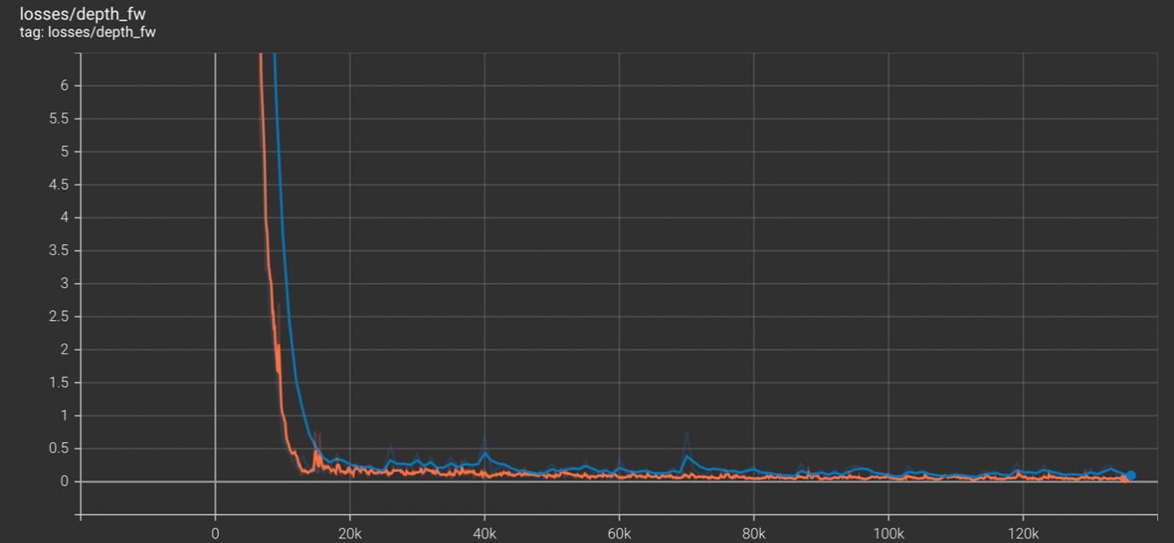
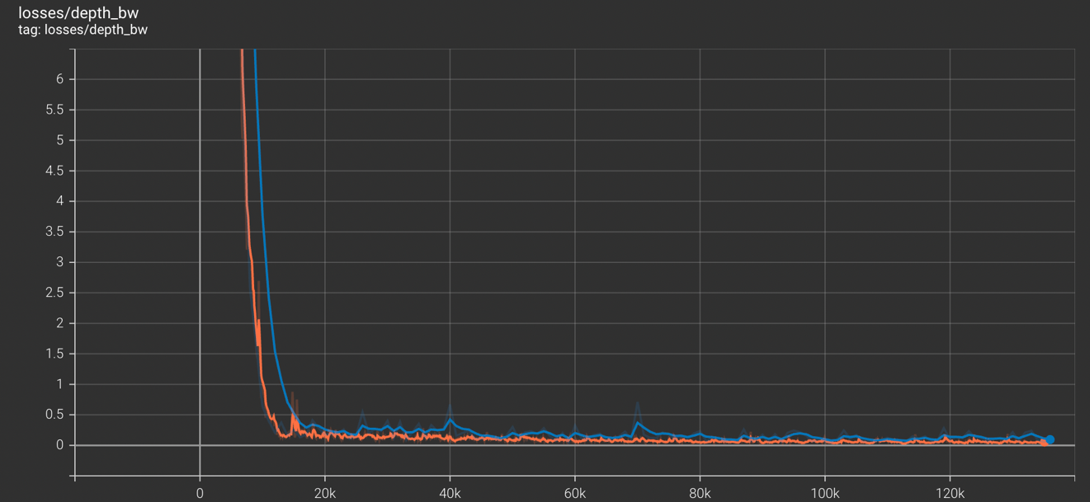
Forward & Backward Estimation Loss

Slide 10
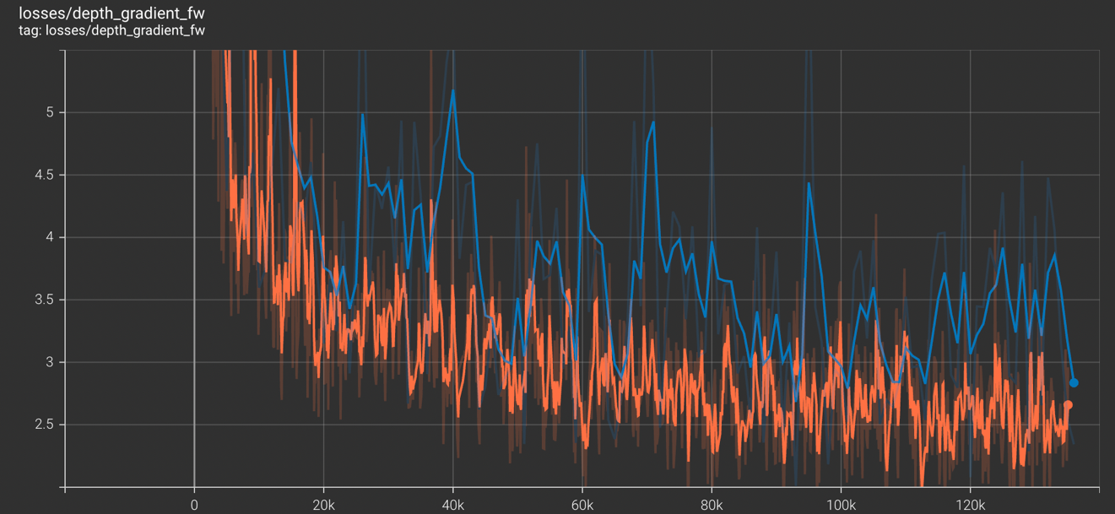
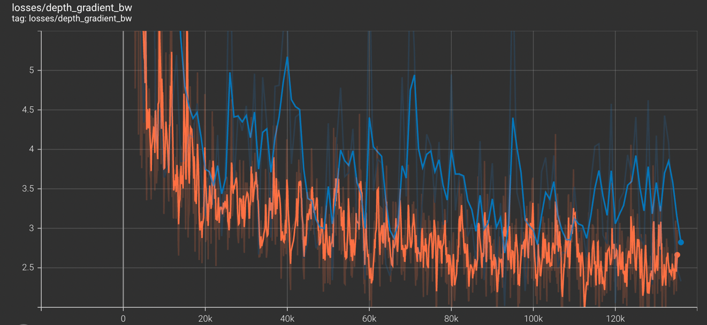
Forward & Backward GRADIENT Loss

Slide 11
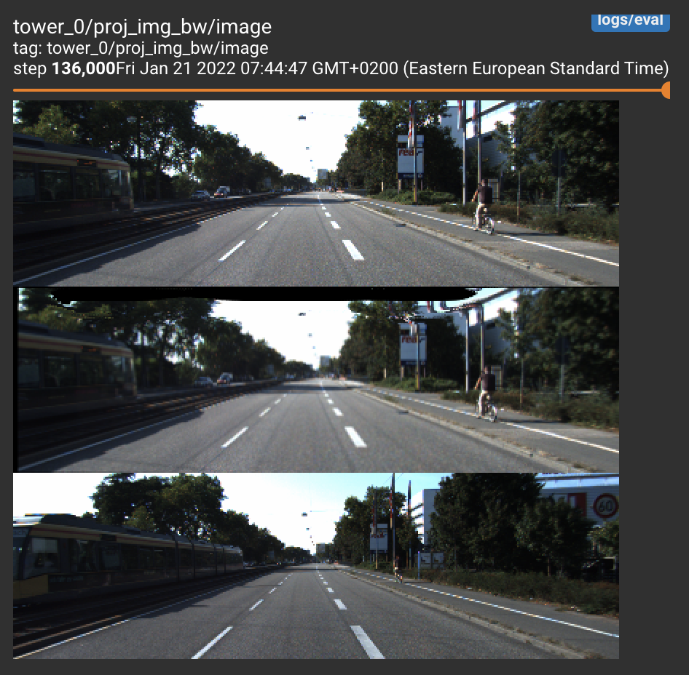
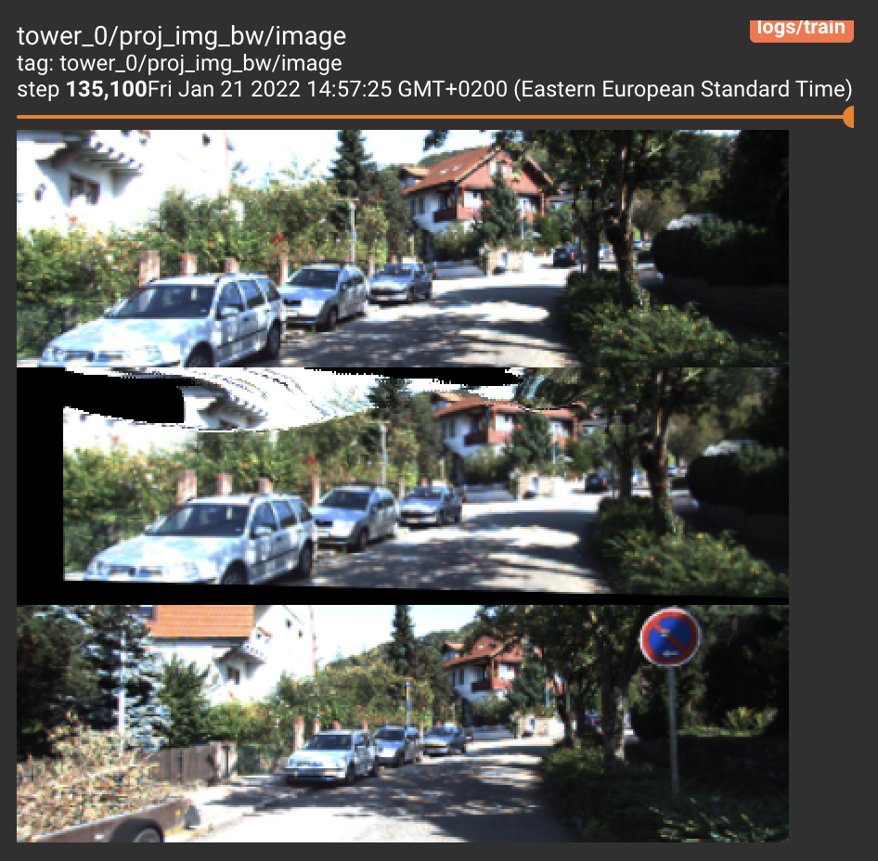
Forward-Backward Flow consistency: projected Images

Slide 12
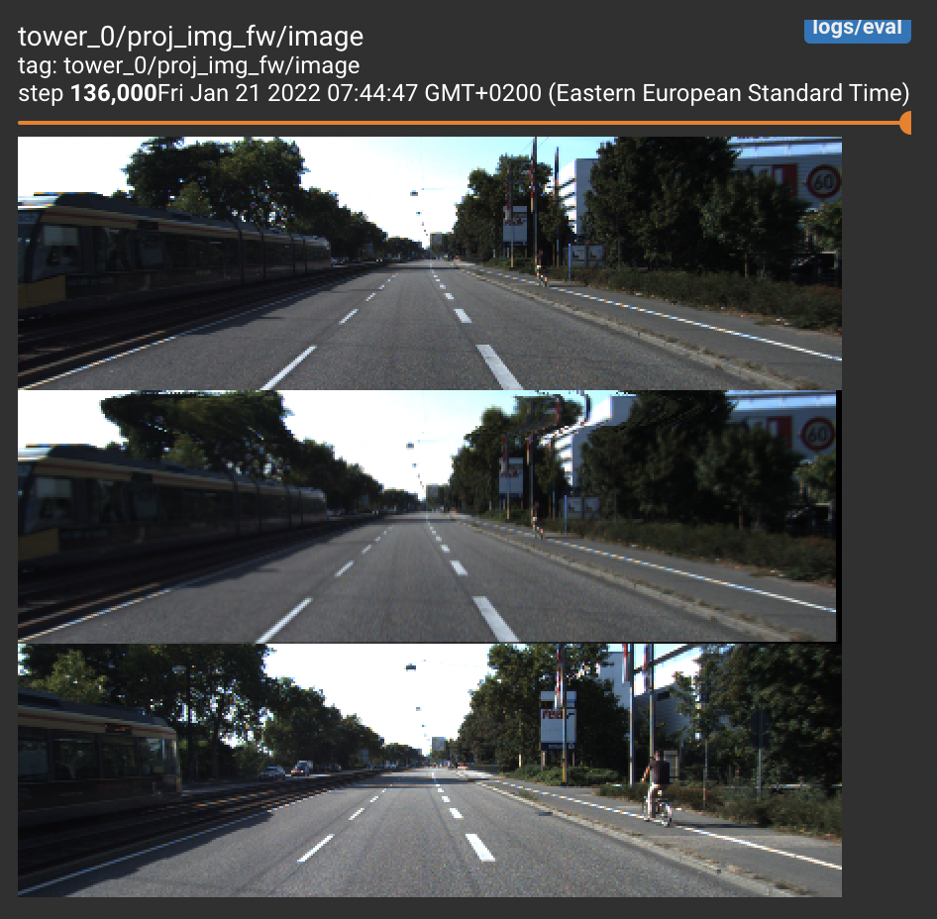
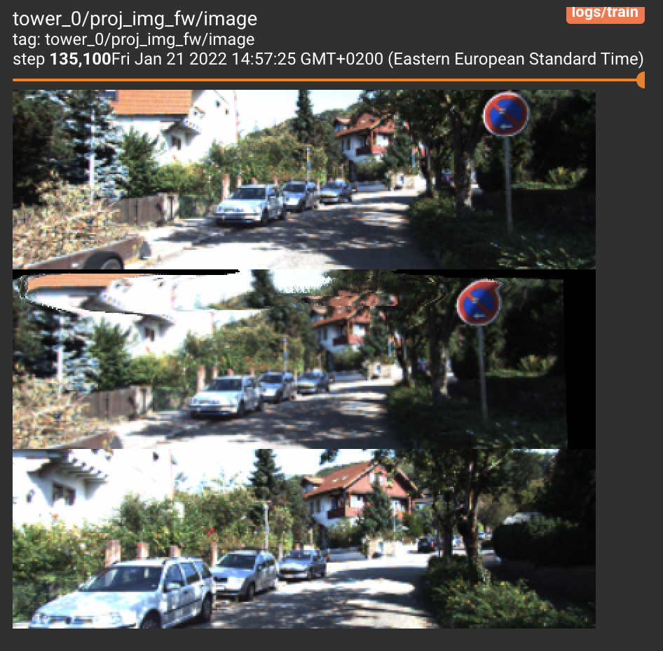
Forward-Backward Flow consistency: projected Images

Slide 13
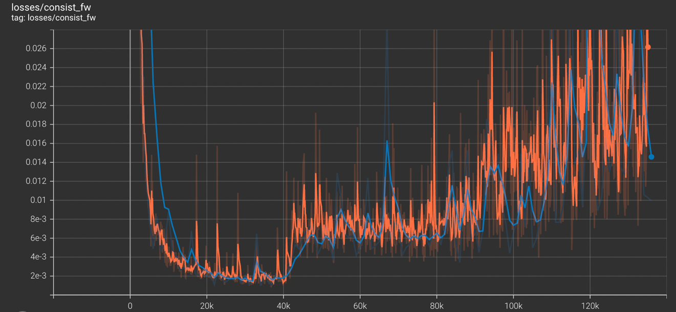

Forward & Backward consistency Loss

Slide 14
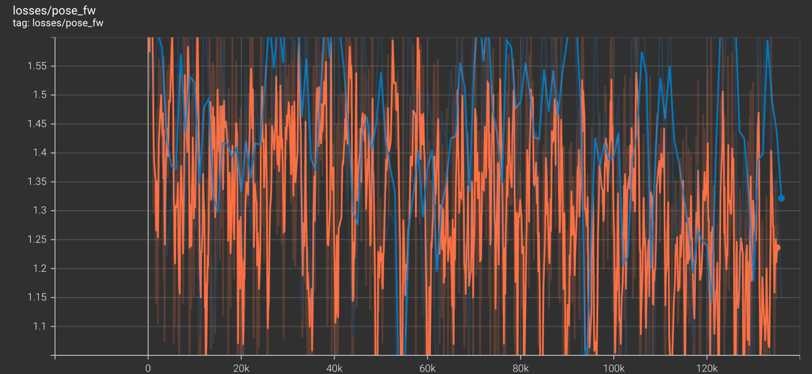
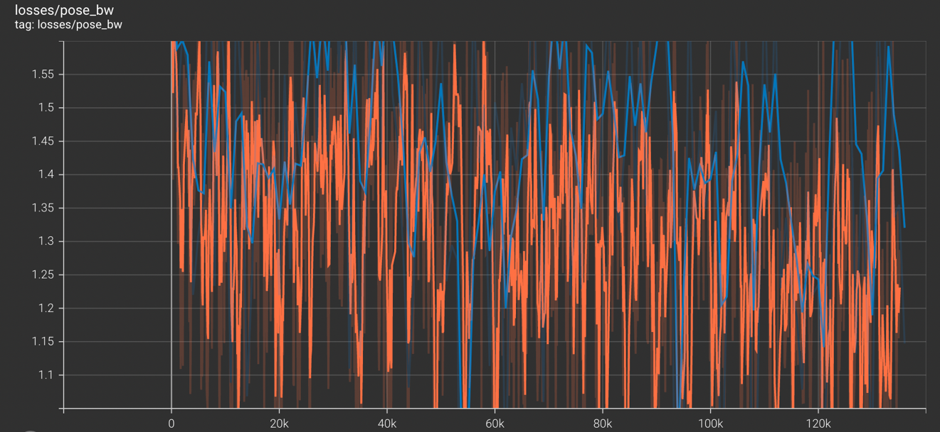
FORWARD & Backward pose estimation loss

Slide 15
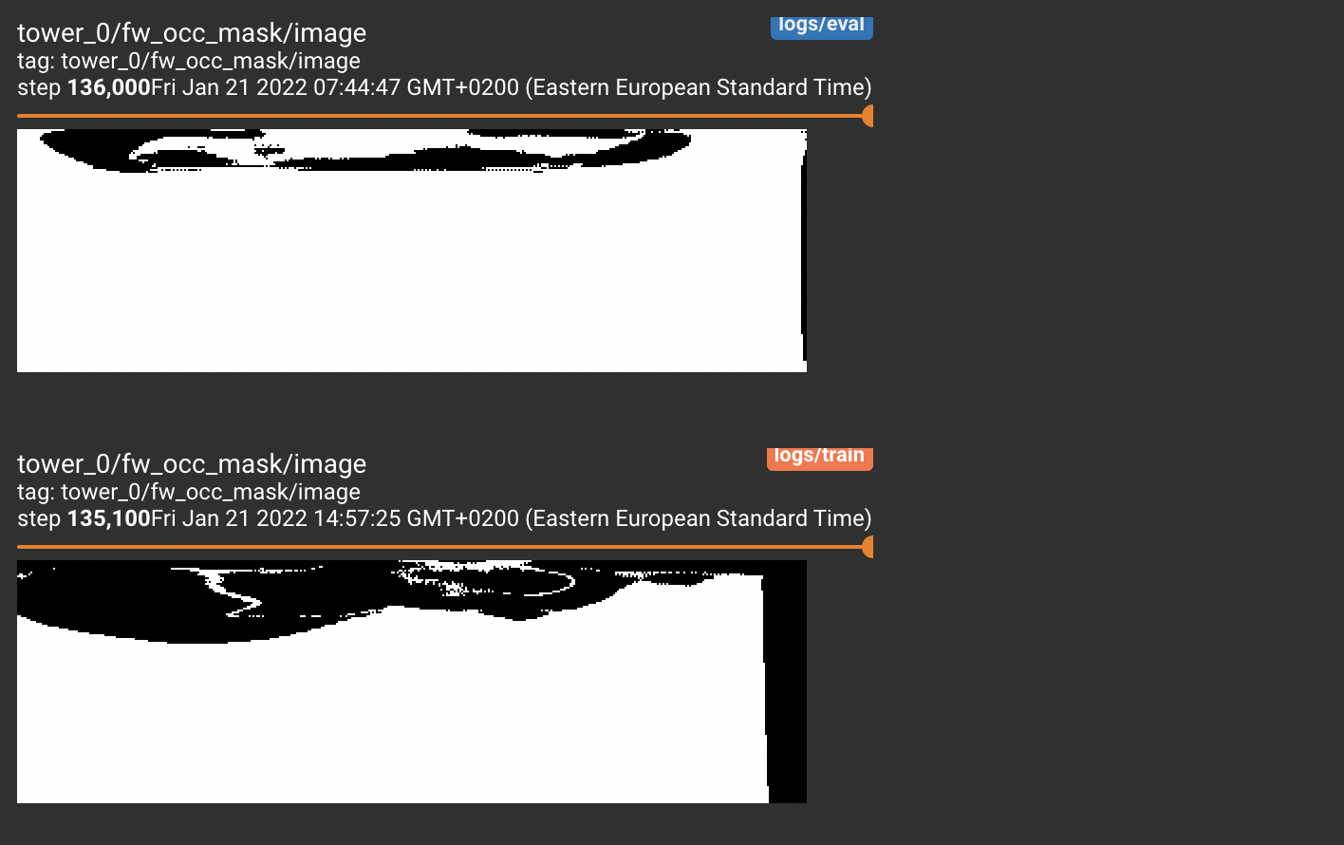
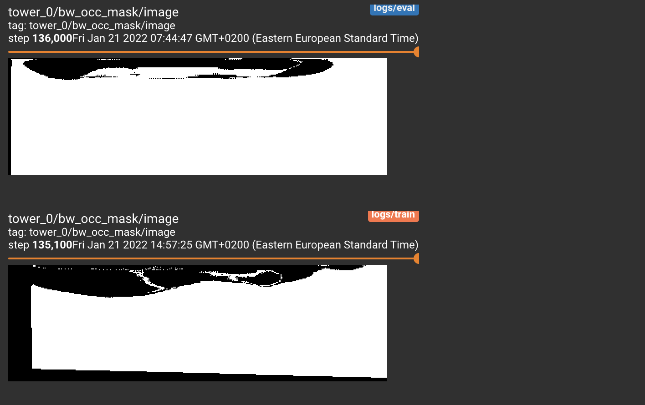
ForWARD & BACKWARD OCCLUSION MASK

Slide 16
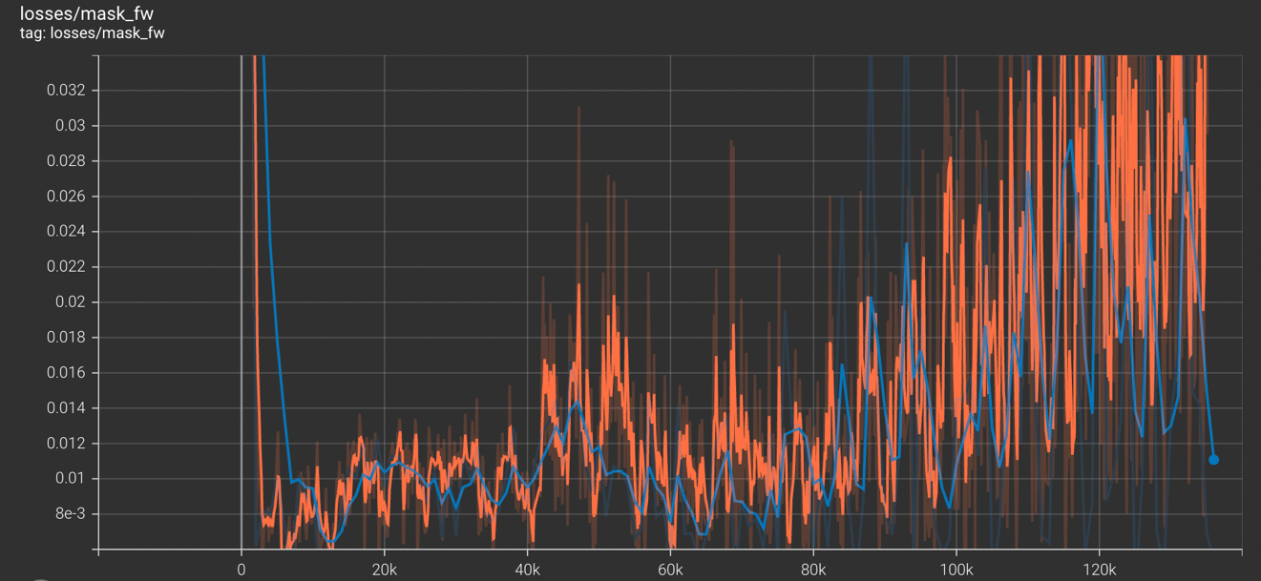
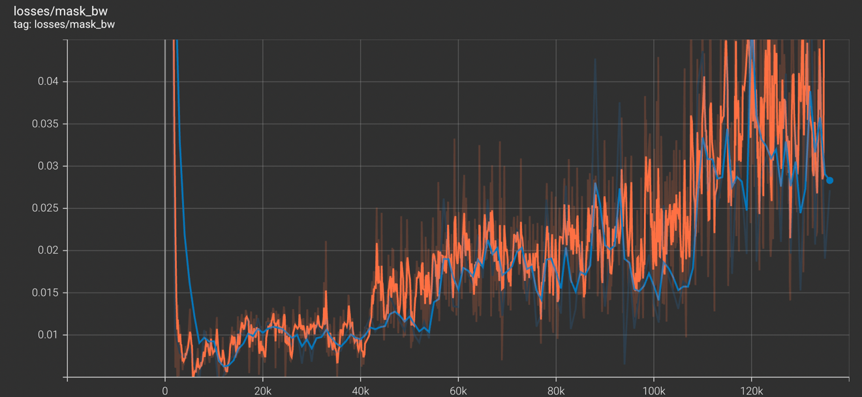
FoRWARD & BACKWARD OCCLUSION MASK lOSS

Slide 17
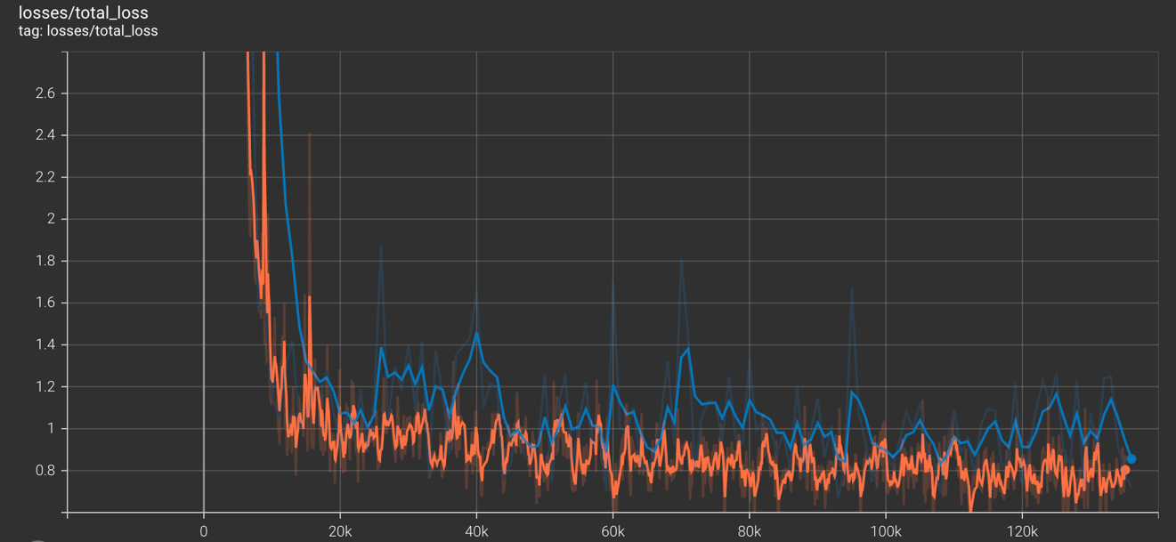
Total loss

Slide 18
Observations
The model needs more training in order to reproduce the paper’s results (10-20 more epochs)
The depth estimation and the image reprojection from qualitative judgement are reaching good reprojection of the images and good depth estimation.
The total loss is continuing to decrease.

Slide 19
Proposed Modifications
1. Initializing the ConvLSTM hidden state instead of initially set to zeros.
2. Removing and Adding losses.
3. Architecture modification:
Try deeper depth and pose estimation network.
Change the number of input sequence.
4. Changing the training procedure:
Freeze some parts of the network for some epochs.
Continue to train them after the first parts stabilize.

